Slide 1

Who is the Best League of Legends Champion?
Riot API Data
Slide Deck

Slide 2








What is the purpose of this course?
Learning to use the Riot API is a bit of a struggle. There's very few resources out there and they're not very structured.
“The Riot API Bootcamp Course is designed to take you from no knowledge up to building your own app.”

Slide 3
Riot API Bootcamp syllabus
Basics (Python, GitHub, Notepad++)
Resources to get started
Setting up an environment
Downloading GitHub repos
JSON explanation & Notepad++ example
Project: read csv file, convert to data frame, create graphs
Riot API introduction
What is an API?
Getting access & Registering your App
What end points are there/what data is available?
Explanation of puuid/account name
Project: make an API call on the website & download the data
Automating API interactions
Introduction to libraries (Cassiopeia, Riot Watcher)
Getting help (documentation, Discord)
Project: automate an API call using a library
Single Endpoint Data
Use case explanation (e.g., in-depth match analysis, leaderboards)
Code example- getting challenger leaderboard
Project: request last 25 games for an account and determine the most common champion(s)
Large Scale Data Collection
Use case explanation (e.g., match history of top 50 players)
Setting up a process pipeline
Comparing 1 file approach vs. functions across files approach
Project: determine number of roles (TOP, MID, etc) on the challenger ladder using the last 5 games
5 Modules covering core topics Project at the end of each

Slide 4
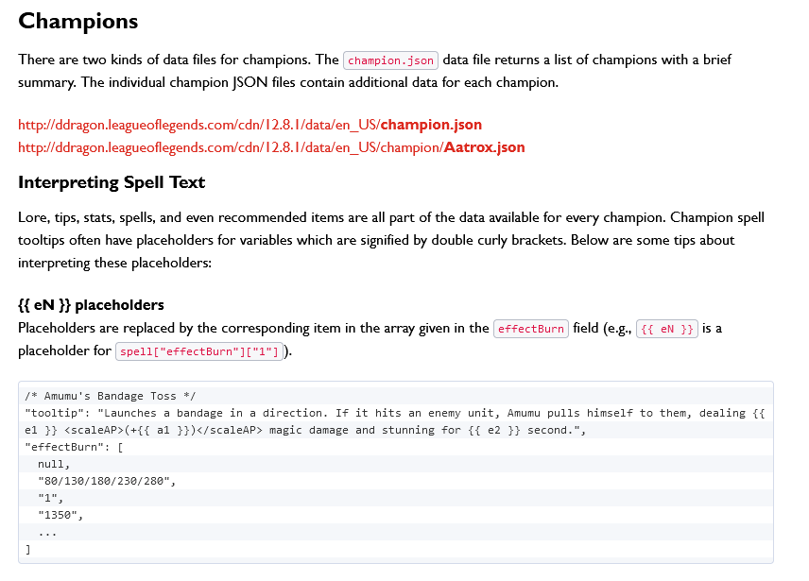
What does the Riot API Provide?
Info can be downloaded as a JSON file via the Riot API web portal
https://developer.riotgames.com/docs/lol
Not always the most accurate
Format changes constantly
Assets scattered in different places
Community projects
https://cdn.merakianalytics.com/riot/lol/resources/latest/en-US/
https://www.communitydragon.org/

Slide 5
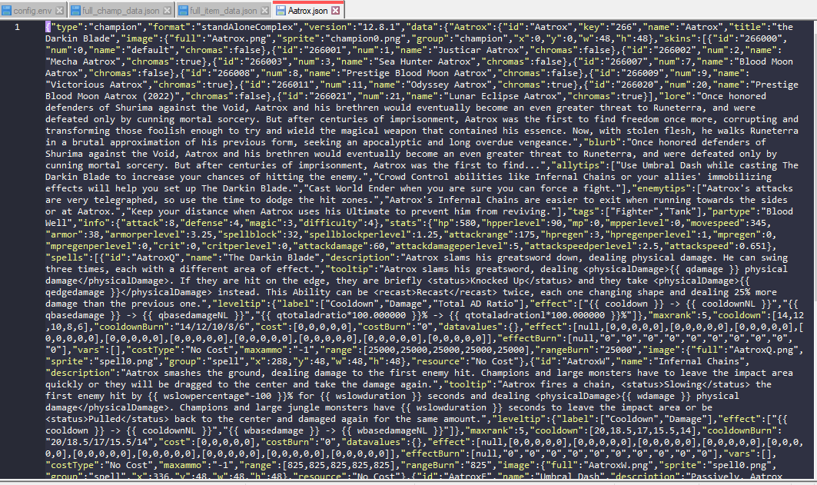
What does the Riot API Provide?
Raw Riot API data for Aatrox

Slide 6
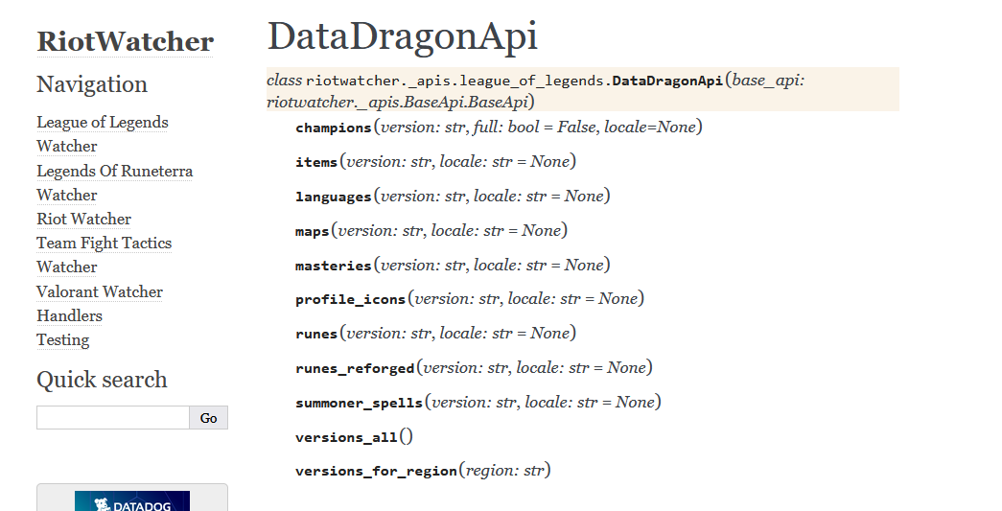
Automating an API request
DEMONSTRATION with
Riot Watcher, DataDragonApi end point
Python library for interacting with Riot API

Slide 7


Questions?
Contact me
It is my hope that this course is easy to understand and follow
Have a question or want additional details? Just reach out!
If you want to know more about my work (LoL Genius) or have questions about something you’re building, LMK!

